Slide 1
BINARY SEARCH TREES!

Slide 2
Instructor
Dr. Ab Rouf Khan
Assistant Professor
VIT Bhopal University

Slide 3
Entry level Questions
How does Google sort the webpages while you are searching for some query?
How is hierarchical information stored in a database?
Can we perform sorting using Tree data structure?

Slide 4
Outline – Binary Search Trees
Binary Search Tree
Properties
Representation
Traversals
Searching
Finding Minimum and Maximum
Insertion
Deletion

Slide 5
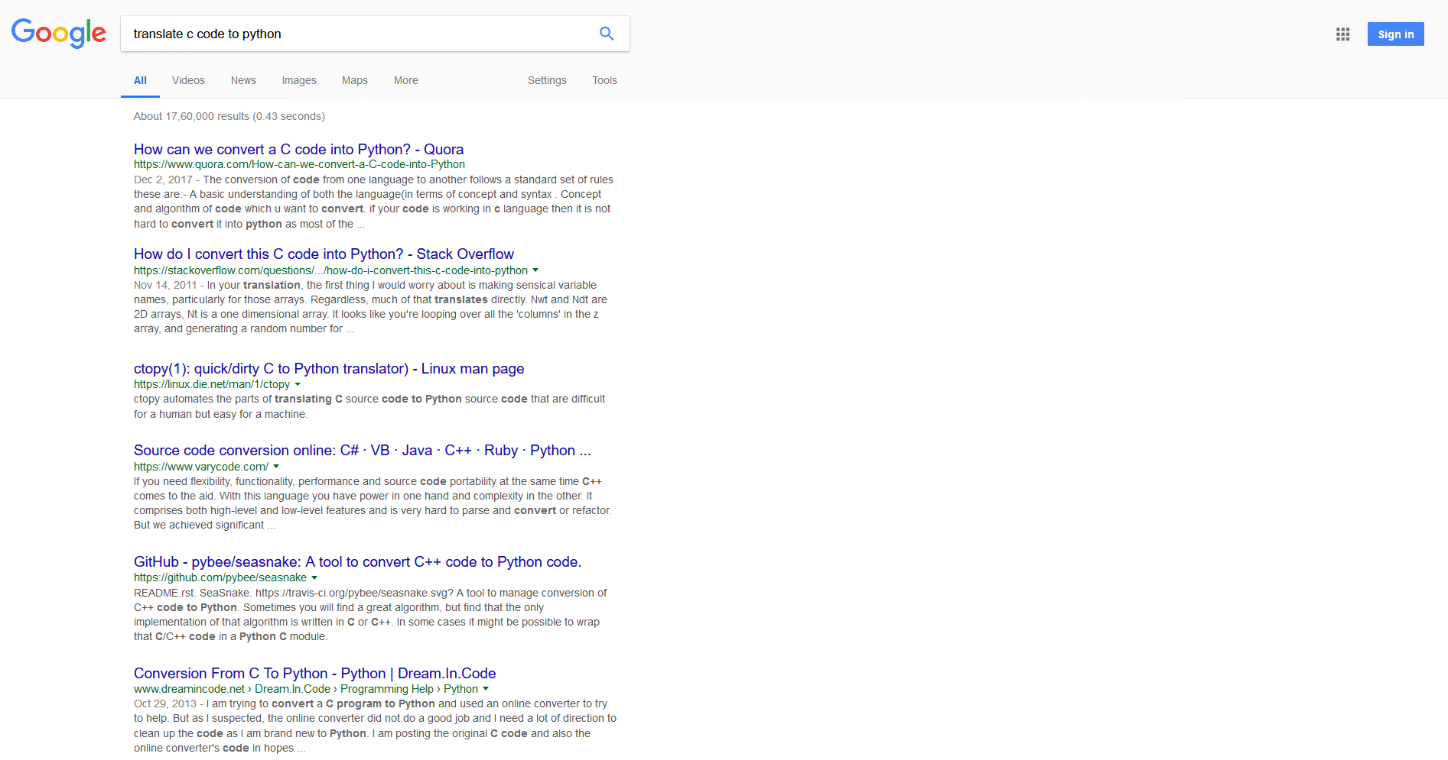
Internet Searches
Most relevant webpage
Google sorts webpages in decreasing relevance to the query you asked!
Less relevant webpage

Slide 6
Binary Search Trees
View today as data structures that can support dynamic set operations.
Search, Minimum, Maximum, Predecessor, Successor, Insert, and Delete.
Can be used to build
Dictionaries.
Priority Queues.
Basic operations take time proportional to the height of the tree – O(h).

Slide 7
BST – Representation
Represented by a linked data structure of nodes.
root(T) points to the root of tree T.
Each node contains fields:
key
left – pointer to left child: root of left subtree.
right – pointer to right child : root of right subtree.
p – pointer to parent. p[root[T]] = NIL (optional).

Slide 8
Binary Search Tree Property
Stored keys must satisfy the binary search tree property.
∀ y in left subtree of x, then key[y] ≤ key[x].
∀ y in right subtree of x, then key[y] ≥ key[x].
56
26
200
18
28
190
213
12
24
27

Slide 9
Binary Search Tree Examples
20
30
60
12
25
5
40
70
10
15
22
2
65
80

Slide 10
Inorder Traversal
The binary-search-tree property allows the keys of a binary search tree to be printed, in (monotonically increasing) order, recursively.
Inorder-Tree-Walk (x)
1. if x ≠ NIL
2. then Inorder-Tree-Walk(left[p])
3. print key[x]
4. Inorder-Tree-Walk(right[p])
56
26
200
18
28
190
213
12
24
27
How long does the walk take?
Can you prove its correctness?

Slide 11
Querying a Binary Search Tree
All dynamic-set search operations can be supported in O(h) time.
h = Θ(lg n) for a balanced binary tree (and for an average tree built by adding nodes in random order.)
h = Θ(n) for an unbalanced tree that resembles a linear chain of n nodes in the worst case.

Slide 12
Tree Search
Tree-Search(x, k)
1. if x = NIL or k = key[x]
2. then return x
3. if k < key[x]
4. then return Tree-Search(left[x], k)
5. else return Tree-Search(right[x], k)
56
26
200
18
28
190
213
Running time: O(h)
12
24
27

Slide 13
Iterative Tree Search
Iterative-Tree-Search(x, k)
1. while x ≠ NIL and k ≠ key[x]
2. do if k < key[x]
3. then x ← left[x]
4. else x ← right[x]
5. return x
56
26
200
18
28
190
213
12
24
27
The iterative tree search is more efficient on most computers.
The recursive tree search is more straightforward.

Slide 14
Finding Min & Max
The binary-search-tree property guarantees that:
The minimum is located at the left-most node.
The maximum is located at the right-most node.
Tree-Minimum(x) Tree-maximum(x)
1. while left[x] ≠ NIL 1. while right[x] ≠ NIL
2. do x ← left[x] 2. do x ← right[x]
3. return x 3. return x
Q: How long do they take?

Slide 15
Predecessor and Successor
Successor of node x is the node y such that key[y] is the smallest key greater than key[x].
The successor of the largest key is NIL.
Search consists of two cases.
If node x has a non-empty right subtree, then x’s successor is the minimum in the right subtree of x.
If node x has an empty right subtree, then:
As long as we move to the left up the tree (move up through right children), we are visiting smaller keys.
x’s successor y is the node that x is the predecessor of (x is the maximum in y’s left subtree).
In other words, x’s successor y, is the lowest ancestor of x whose left child is also an ancestor of x.

Slide 16
Pseudo-code for Successor
Tree-Successor(x)
if right[x] ≠ NIL
2. then return Tree-Minimum(right[x])
3. y ← p[x]
4. while y ≠ NIL and x = right[y]
5. do x ← y
6. y ← p[y]
7. return y
56
26
200
18
28
190
213
Code for predecessor is symmetric.
Running time: O(h)
12
24
27

Slide 17
BST Insertion – Pseudocode
Change the dynamic set represented by a BST.
Ensure the binary-search-tree property holds after change.
Insertion is easier than deletion.
Tree-Insert(T, z)
y ← NIL
x ← root[T]
while x ≠ NIL
do y ← x
if key[z] < key[x]
then x ← left[x]
else x ← right[x]
p[z] ← y
if y = NIL
then root[t] ← z
else if key[z] < key[y]
then left[y] ← z
else right[y] ← z
56
26
200
18
28
190
213
12
24
27

Slide 18
BST Insertion – Example
30
30
30
40
5
40
5
40
5
2
80
2
35
80
2
Insert 80
Insert 35

Slide 19
Analysis of Insertion
Initialization: O(1)
While loop in lines 3-7 searches for place to insert z, maintaining parent y. This takes O(h) time.
Lines 8-13 insert the value: O(1)
⇒ TOTAL: O(h) time to insert a node.
Tree-Insert(T, z)
y ← NIL
x ← root[T]
while x ≠ NIL
do y ← x
if key[z] < key[x]
then x ← left[x]
else x ← right[x]
p[z] ← y
if y = NIL
then root[t] ← z
else if key[z] < key[y]
then left[y] ← z
else right[y] ← z

Slide 20
Exercise: Sorting Using BSTs
Sort (A)
for i ← 1 to n
do tree-insert(A[i])
inorder-tree-walk(root)
What are the worst case and best case running times?
In practice, how would this compare to other sorting algorithms?

Slide 21
Binary Search Tree-Delete (T, x)
if x has no children ♦ case 0
then remove x
if x has one child ♦ case 1
then make p[x] point to child
if x has two children (subtrees) ♦ case 2
then swap x with its successor
perform case 0 or case 1 to delete it
⇒ TOTAL: O(h) time to delete a node

Slide 22
BST Deletion – Pseudocode (1)
Tree-Delete(T, z)
/* Determine which node to splice out: either z or z’s successor. */
if left[z] = NIL or right[z] = NIL
then y ← z
else y ← Tree-Successor[z]
/* Set x to a non-NIL child of x, or to NIL if y has no children. */
if left[y] ≠ NIL
then x ← left[y]
else x ← right[y]
/* y is removed from the tree by manipulating pointers of p[y] and x */
if x ≠ NIL
then p[x] ← p[y] /* Continued on next slide */

Slide 23
BST Deletion – Pseudocode (2)
Tree-Delete(T, z) (Contd. from previous slide)
if p[y] = NIL
then root[T] ← x
else if y ← left[p[i]]
then left[p[y]] ← x
else right[p[y]] ← x
/* If z’s successor was spliced out, copy its data into z */
if y ≠ z
then key[z] ← key[y]
copy y’s satellite data into z.
return y

Slide 24
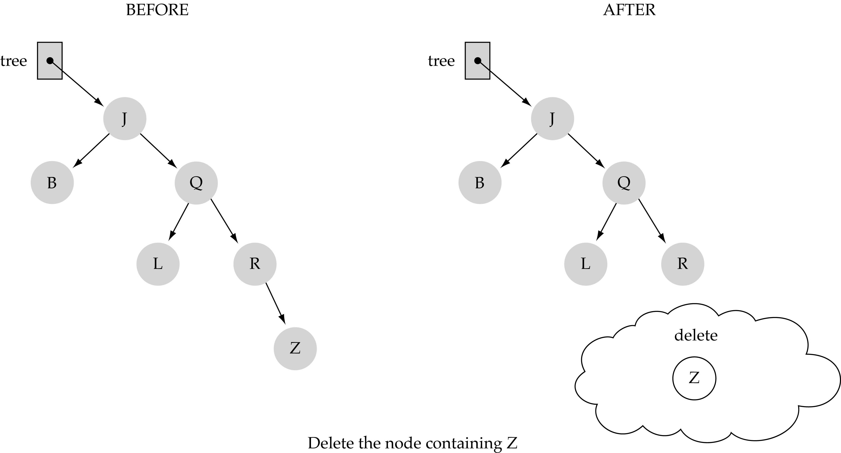
(1) Deleting a leaf

Slide 25
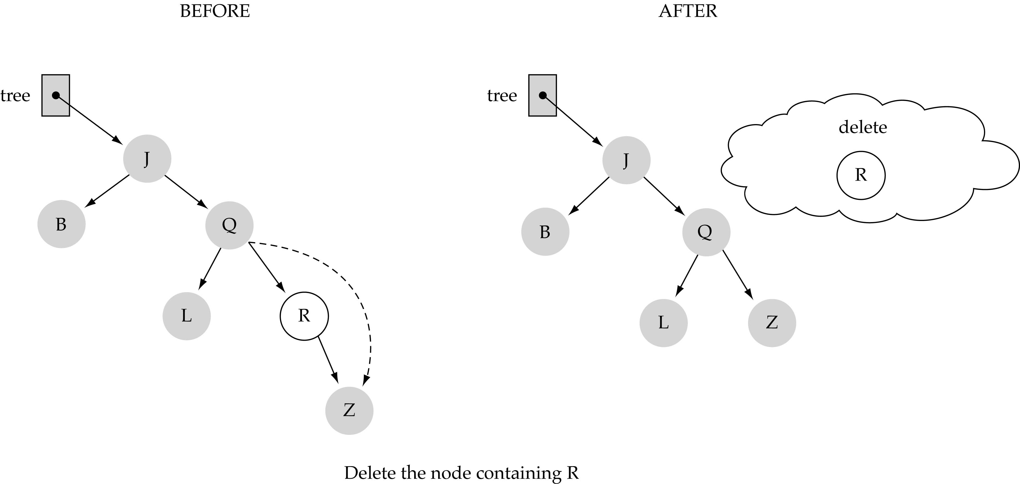
(2) Deleting a node with only one child

Slide 26
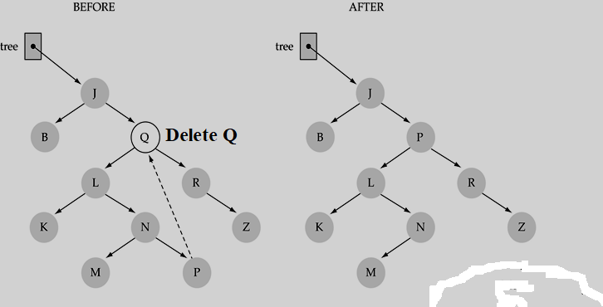
(3) Deleting a node with two children

Slide 27
Correctness of Binary Search Tree-Delete
How do we know case 2 should go to case 0 or case 1 instead of back to case 2?
Because when x has 2 children, its successor is the minimum in its right subtree, and that successor has no left child (hence 0 or 1 child).
Equivalently, we could swap with predecessor instead of successor. It might be good to alternate to avoid creating lopsided tree.

Slide 28
Balanced BST’s
Balanced BSTs: h is Theta(lg n)
Red-Black trees
AVL trees
2-3-4 trees
B-trees

Slide 29
Red-Black Tree!

Slide 30
Red-black trees: Overview
Red-black trees are a variation of binary search trees to ensure that the tree is balanced.
Height is O(lg n), where n is the number of nodes.
Operations take O(lg n) time in the worst case.

Slide 31
Red-black Tree
Binary search tree + 1 bit per node: the attribute color, which is either red or black.
All other attributes of BSTs are inherited:
key, left, right, and p.
All empty trees (leaves) are colored black.
We use a single sentinel, nil, for all the leaves of red-black tree T, with color[nil] = black.
The root’s parent is also nil[T ].

Slide 32
Red-black Tree – Example
26
17
41
30
47
38
50
nil[T]

Slide 33
Red-black Properties
Every node is either red or black.
The root is black.
Every leaf (nil) is black.
If a node is red, then both its children are black.
For each node, all paths from the node to descendant leaves contain the same number of black nodes.

Slide 34
Height of a Red-black Tree
Height of a node:
Number of edges in a longest path to a leaf.
Black-height of a node x, bh(x):
bh(x) is the number of black nodes (including nil[T ]) on the path from x to leaf, not counting x.
Black-height of a red-black tree is the black-height of its root.
By Property 5, black height is well defined.

Slide 35
Height of a Red-black Tree
h=4
bh=2
Example:
Height of a node:
Number of edges in a longest path to a leaf.
Black-height of a node bh(x) is the number of black nodes on path from x to leaf, not counting x.
26
h=3
bh=2
17
h=1
bh=1
41
h=2
bh=1
h=2
bh=1
30
47
h=1
bh=1
38
h=1
bh=1
50
nil[T]

Slide 36
AVL Tree!

Slide 37
AVL (Height-balanced Trees)
An AVL (Adelson-Velskii and Landis) tree (or height-balanced tree) is a binary search tree such that:
The height of the left and right subtrees of the root differ by at most 1 (i.e., height(LST)-height(RST)=0 / 1/ -1)
The left and right subtrees of the root are AVL trees

Slide 38
AVL Trees (Examples)

Slide 39
Non-AVL Trees

Slide 40
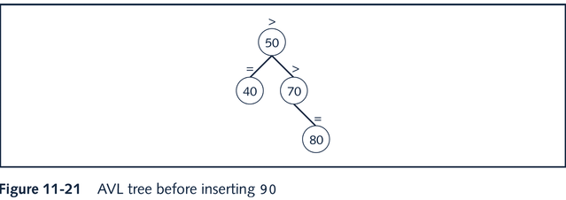
Insertion Into AVL Tree (Example)
Insert Node 90

Slide 41
Insertion Into AVL Tree (Example)

Slide 42
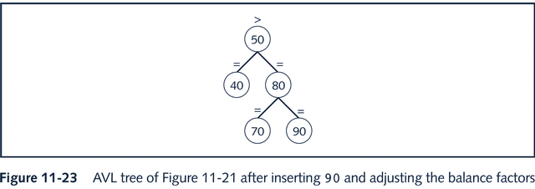
Insertion Into AVL Tree (Example)

Slide 43
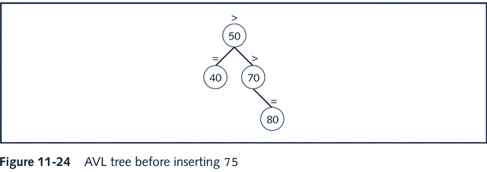
Insertion Into AVL Tree (Example)
Insert Node 75

Slide 44
Insertion Into AVL Tree (Example)

Slide 45
AVL Tree Rotations
Reconstruction procedure: rotating tree
left rotation and right rotation
Suppose that the rotation occurs at node x
Left rotation: certain nodes from the right subtree of x move to its left subtree; the root of the right subtree of x becomes the new root of the reconstructed subtree
Right rotation at x: certain nodes from the left subtree of x move to its right subtree; the root of the left subtree of x becomes the new root of the reconstructed subtree

Slide 46
AVL Tree Rotations

Slide 47
AVL Tree Rotations

Slide 48
AVL Tree Rotations

Slide 49
AVL Tree Rotations

Slide 50
AVL Tree Rotations

Slide 51
AVL Tree Rotations

Slide 52
Deletion From AVL Trees
Case 1: the node to be deleted is a leaf
Case 2: the node to be deleted has no right child, that is, its right subtree is empty
Case 3: the node to be deleted has no left child, that is, its left subtree is empty
Case 4: the node to be deleted has a left child and a right child

Slide 53
Summary
Binary Search Trees
Properties, Insertion, Deletion, Quering
Height-Balanced BSTs
Red-Black Tree
Height, Properties.
AVL Tree
Height, Insertion, Deletion, and Rotations.

Slide 54

Recap

Slide 55
Thank You!

